Slide 1
EETS 8332: Advanced Network Design
Dr. M. Scott Kingsley

Slide 2
BGP Terms
IGP (Interior Gateway Protocol) - RIP, IGRP, EIGRP, OSPF = Routing protocol used to exchange routing information within an autonomous system.
EGP (Exterior Gateway Protocol) - BGP = Routing protocol used to exchange routing information between autonomous systems.
Autonomous System = (From RFC 1771) “A set of routers under the single technical administration, using an IGP and common metrics to route packets within the AS, and using an EGP to route packets to other AS’s.”
BGP is a path vector or an advanced distance vector routing protocol.

Slide 3
EGPs – Exterior Gateway Protocols
Typically, EGPs are used to exchange routing information between ISPs, or in some cases between a customer’s AS and the provider’s network.
Border Gateway Protocol (BGP), version 4 (BGP4) is the most common EGP and is considered the Internet standard.

Slide 4
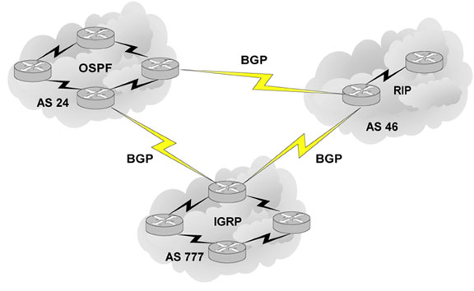
BGP – an Exterior Gateway Protocol

Slide 5
Autonomous Systems
An internetwork is a confederation of smaller, independent networks.
Each of these smaller networks may be owned and operated by a different organization: a company, university, government agency, or some other group.
Since the routing and security policies of one organization may conflict with the policies of another, internetworks are divided into domains, or autonomous systems.
Each AS typically represents an independent organization, and applies its own unique routing and security policies.
EGPs facilitate the sharing of routing information between autonomous systems.

Slide 6
AS Numbers
Each AS has an identifying number, assigned by an Internet registry or a service provider, between 1 and 65535.
Private AS numbers: Between 64512 through 65535
Because of the finite number of available AS numbers, an organization must present justification of its need before it will be assigned an AS number.

Slide 7
AS Numbers
Organizations that connect to a single provider and share the provider’s routing policies use an AS number from the private pool (64,512-65,535).
These private AS numbers appear only within the provider’s network, and are replaced by the provider’s registered number upon exiting the network. us, to the

Slide 8
BGP Basics
BGP is a path vector routing protocol.
The node makes its route calculations based on those advertised routes and passes the results to upstream neighbors.
BGP uses a list of AS numbers through which a packet must pass to reach a destination.

Slide 9
BGP Basics
The list of AS numbers associated with a BGP route is called the AS_PATH and is one of several path attributes associated with each route.
Path attributes will be discussed in much more detail later.
The shortest inter-AS path is very simply determined by the least number of AS numbers.
All things being equal, BGP prefers routes with shorter AS paths.
In this example, AS1-AS7 will choose the shortest path (4, 2, 1).
We will see later what happens with equal cost paths.

Slide 10
BGP Basics (AS1-AS7)

Slide 11
BGP Basics
Routing Loop Avoidance
Route loops can be easily detected when a router receives an update containing its local AS number in the AS_PATH.
When this occurs, the router will not accept the update, thereby avoiding a potential routing loop.

Slide 12
BGP Basics

Slide 13
BGP Basics
BGP4 is the first version of BGP that supports CIDR and route aggregation.
BGP does not use technical metrics, instead, BGP makes routing decisions based on network policies.
BGP does not show the details of topologies within each AS.
BGP sees only a tree of autonomous systems.
Cisco routers maintain a separate routing table to hold BGP routes.

Slide 14
iBGP versus EBGP
When BGP is running inside an AS, it is referred to as Internal BGP (IBGP).
If a BGP router’s role is to route IBGP traffic, it is called a transit router.
When BGP runs between autonomous systems, it is called External BGP (EBGP).
Routers that sit on the boundary of an AS and use EBGP to exchange information with the ISP are called border routers.
With few exceptions, interior BGP (IBGP) – BGP between peers in the same AS – is used only in multi-homed scenarios.

Slide 15
iBGP versus EBGP
EBGP: Between Taos and Vail
IBGP: Between Vail and Aspen
IBGP
EBGP

Slide 16
iBGP versus Static Routes
When to use iBGP versus a static route to your provider:
When the effects of BGP are well understood and one of the following conditions exist:
The AS allows packets to transit through it to reach another AS (transit AS).
The AS has multiple connections to other AS’s.
The flow of traffic entering or exiting the AS must be manipulated. This is policy based routing and based on attributes.

Slide 17
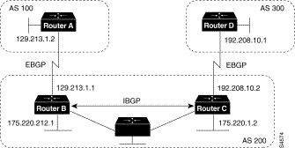
BGP Peers

Slide 18
BGP Peers
Routers A and B are running EBGP, and Routers B and C are running IBGP.
Note that the EBGP peers are directly connected and that the IBGP peers are not. (They can be.)
As long as there is an IGP running that allows the two neighbors to reach one another, IBGP peers do not have to be directly connected.
See second slide after this one.

Slide 19
BGP Peers
All BGP speakers within an AS must establish a peer relationship with each other, that is, the BGP speakers within an AS must be fully meshed logically.
BGP4 provides two techniques that alleviate the requirement for a logical full mesh: confederations and route reflectors.
AS 200 is a transit AS for AS 100 and AS 300---that is, AS 200 is used to transfer packets between AS 100 and AS 300.
See next slide

Slide 20
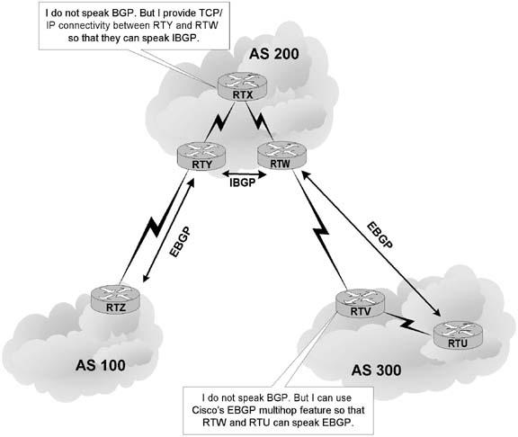
EBGP versus IBGP
EBGP peers must be directly connected, but there are certain exceptions to this requirement.
In contrast, IBGP peers merely require TCP/IP connectivity within the same AS.
As long as RTY can communicate with RTW using TCP, both routers can establish an IBGP session.
If needed, an IGP such as OSPF can provide IBGP peers with routes to each other.

Slide 21
IBGP
In a typical configuration, an IBGP router maintains IBGP sessions with all other IBGP routers in the AS, forming a logical full-mesh.
This is necessary because IBGP routers do not advertise routes learned via IBGP to other IBGP peers (to prevent routing loops).
In other words, if you want your IBGP routers to exchange BGP routes with each other, you should configure a full-mesh.
An alternative to this approach: configuring a route reflector (In few slides)

Slide 22
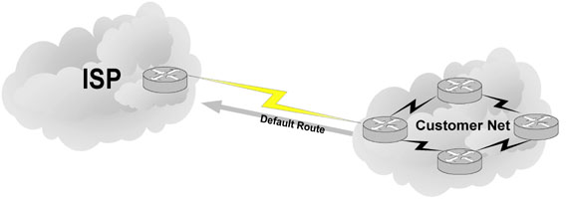
Single-Homed AS
ip route 0.0.0.0 0.0.0.0
If an AS has only one exit point to outside networks, it is considered a single-homed system.
Single-homed autonomous systems are often referred to as stub networks, or stubs.
Stubs can rely on a default route to handle all traffic destined for nonlocal networks.
BGP is not normally needed in this situation.

Slide 23
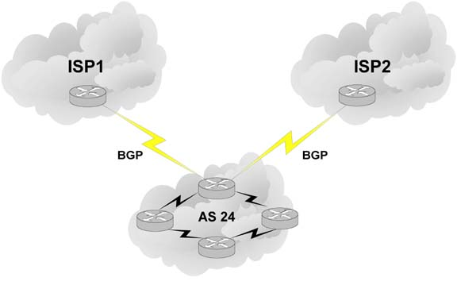
Multi-homed Autonomous Systems
Same ISP
An AS is a multi-homed system if it has more than one exit point to outside networks.
An AS connected to the Internet can be multi-homed to:
a single provider (AS)
multiple providers (ASs)

Slide 24
Multi-homed to a Single Autonomous Systems
This is an improved topology over Single-Home AS, providing for redundancy.
One option may be to use one link as the primary link and the other as a backup link.

Slide 25
Multi-homed to a Single Autonomous Systems
Summarized network address
0.0.0.0/0 Cost = 10 Type = E1
OSPF
0.0.0.0/0 Cost = 10 Type = E1
A better design would be to use both paths, with each one providing backup for the other in the event of link or router failure.
One example would be to run a dynamic routing protocol like OSPF within your network, with static default routes advertised at both campus entrance routers into your network.
As a result, every router chooses the closest exit point, when choosing a default route.
In most cases this will be sufficient for good internetwork performance.

Slide 26
Multi-homed to a Single Autonomous Systems
Santa Cruz
Paris
If the geographical separation between the two entrance routers is large enough for delay variations to become significant (one router closer to some networks, while the other router is closer to other networks), you might have a need for better control of the routing.
In this case BGP might be a consideration.

Slide 27
Multi-homed to a Single Autonomous Systems
Incoming route advertisements influence your outgoing traffic, and outgoing advertisements influence your incoming traffic.
If the provider advertises routes into your AS via BGP, your internal routers have more accurate information about external destinations.
BGP also provides tools for setting routing policies for external destinations.
If your internal routes are advertised to the provider via BGP, you have influence over which routes are advertised at which exit point.
BGP also provides tools for your influencing (to some degree) the choices the provider makes when sending traffic into your AS.

Slide 28
Multi-homed Non-transit Autonomous Systems
X
A non-transit AS does not allow transit traffic-that is, any traffic that has a source and destination outside the AS—to pass through it.
A non-transit AS would advertise only its own routes to both the providers it connects to—it would not advertise routes it learned from one provider to another.

Slide 29
Multi-homed Non-transit Autonomous Systems
X
Multi-homed non-transit autonomous systems don’t really need to run BGP4 with their providers, although it is recommended, and often required by ISPs.
BGP4 offers numerous advantages, including increased control of route propagation and filtering.

Slide 30
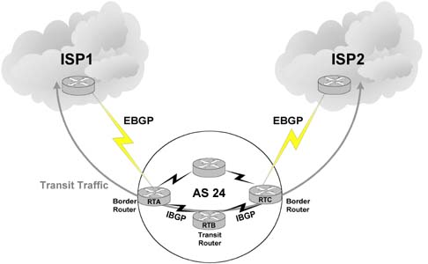
Multi-homed Transit Autonomous Systems
A multi-homed transit system has more than one connection to the outside world and can be used for transit traffic by other autonomous systems.
From the point of view of the multi-homed AS, transit traffic is any traffic originating from outside sources bound for outside destinations

Slide 31
WHEN NOT TO USE BGP
Do not use BGP if you have one or more of the following conditions:
A single connection to the Internet or another AS
No concern for routing policy or routing selection
A lack of memory or processing power on your routers to handle constant BGP updates
A limited understanding of route filtering and BGP path selection process
Low bandwidth between AS’s

Slide 32
WHEN TO USE IBGP
Multiple connections to ISP or other AS’s.
Want more control over traffic routing.

Slide 33
BGP Operation
BGP updates are carried using TCP on port 179.
RIP updates use UDP port 520, while OSPF does not use a Layer-4 protocol.
Because BGP requires TCP, IP connectivity must exist between BGP peers and TCP connections must be negotiated between them before updates can be exchanged.
Thus, BGP inherits TCP’s reliable, connection-oriented properties.

Slide 34
BGP Operation
When two routers establish a TCP-enabled BGP connection between each other, they are called neighbors or peers.
Each router running BGP is called a BGP speaker.
When two neighbors first establish a BGP connection, they exchange their entire BGP routing tables.
After that, they exchange incremental, partial updates with only the information that has changed.

Slide 35
BGP Operation
Peers exchange keepalive messages to ensure the connection is maintained.
The Cisco default keepalive interval is 60 seconds (RFC 1771 does not specify a standard time).
If three keepalive intervals (180 seconds) pass the peer delcares its neighbor down.

Slide 36
BGP Hazards
Creating a BGP “peering” relationship involves an interesting combination of trust and mistrust.
You must trust the network administrator on that end to know what they are doing.
At the same time, if you are smart, you will take every practical measure to protect yourself in the event that a mistake is made on the other end.

Slide 37
BGP Hazards
Your ISP will show little patience with you if you make mistakes in your BGP configuration.
Suppose, for example, that through some misconfiguration you advertise 207.46.0.0/16 to your ISP.
On the receiving side, the ISP does not filter out this incorrect route, allowing it to be advertised to the rest of the Internet.
This particular CIDR block belongs to Microsoft, and you have just claimed to have a route to that destination.

Slide 38
BGP Hazards
A significant portion of the Internet community could decide that the best path to Microsoft is through your domain.
You will receive a flood of unwanted packets across your Internet connection and, more importantly, you will have black-holed traffic that should have gone to Microsoft.
They will be neither amused nor understanding.

Slide 39
BGP Hazards: Another Example
We inadvertently advertise routes learned from ISP2 to ISP1.
ISP1 customers will see our network as the best path to ISP2 customers.
We have become a transit domain for packets from ISP1 to ISP2.

Slide 40
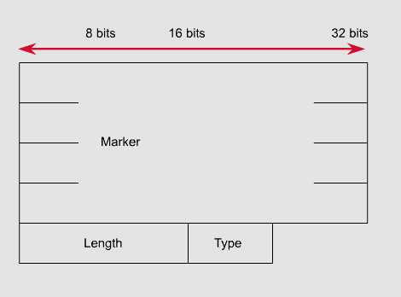
BGP Message Types
Each BGP Message contains the following header:
Marker: The marker field is used to either authenticate incoming BGP messages or to detect loss of synchronization between two BGP peers.
Length: The length field indicates the total BGP message length, including the header.

Slide 41
BGP Message Types
Before establishing a BGP peer connection the two neighbors must perform the standard TCP three-way handshake and open a TCP connection to port 179.
After the TCP session is established, BGP peers exchanges several messages to open and confirm connection parameters and to send BGP routing information.
All BGP messages are unicast to the one neighbor over the TCP connection.
There are four BGP message types:
Type 1: OPEN
Type 2: KEEPALIVE
Type 3: UPDATE
Type 4: NOTIFICATION

Slide 42
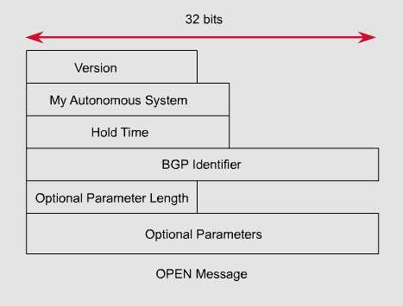
BGP Message Type 1: Open
After the TCP session is established, both neighbors send Open messages.
Each neighbor uses this message to identify itself and to specify its BGP operational parameters including:
BGP version number (defaults to version 4)
AS number: AS number of the originating router, determines if BGP session is EBGP or IBGP.
BGP identifier: IP address that identifies the neighbor using the same method as OSPF router ID.
Optional parameter: authentication, multiprotocol support and route refresh.

Slide 43
BGP Message Type 2: Keepalive
If a router accepts the parameters specified in its neighbor’s Open message, it responds with a keepalive.
Subsequent keepalives are sent every 60 seconds by Cisco default or equal to one-third the agreed-upon hold time (180 seconds).

Slide 44
BGP Message Type 3: Update
The UPDATE messages contain all the information BGP uses to construct a loop-free picture of the internetwork.
Update messages advertises feasible routes, withdrawn routes, or both.
The three basic components of an UPDATE message are:
Network-Layer Reachability Information (NLRI)
Path Attributes
Withdrawn Routes

Slide 45
BGP Message Type 3: Update
Network-Layer Reachability Information (NLRI)
This is one or more (Length, Prefix) tuples that advertise IP address prefixes and their lengths.
192.168.160.0/19
Length = /19
Prefix = 192.168.160.0
Path Attributes
This is described later, providing the information that allows BGP to choose a shortest path, detect routing loops, and determine routing policy.
Withdrawn Routes
These are (Length, Prefix) tuples describing destination that have become unreachable and are being withdrawn from service.

Slide 46
BGP Message Type 4: Notification
A NOTIFICATION message is sent whenever an error is detected and always causes the BGP connection to close.
The NOTIFICATION message is composed of the Error Code (8 bits), Error Subcode (8 bits), and a Data fields (variable length).

Slide 47
Path Attributes
Much of the work you will do configuring BGP focuses on path attributes.
Each route has its own set of defined attributes, which can include path information, route preference, next-hop, and aggregation information.
Administrators use these values to enforce routing policy.
Based on attribute values, you can configure BGP to filter routing information, prefer certain paths, or otherwise customize its behavior.
Every UPDATE message has a variable-length sequence of path attributes in the form <attribute type, attribute length, attribute value>.

Slide 48
Path Attributes
Since you will use path attributes extensively when configuring routing policy, you should note that not all vendor implementations of BGP recognize the same attributes. In fact, path attributes come in four different types:
Well-known mandatory
Well-known discretionary
Optional transitive
Optional non-transitive

Slide 49
Path Attributes
Well-known mandatory
An attribute that has to exist in the BGP UPDATE packet.
It must be recognized by all BGP implementations.
If a well-known attribute is missing, a notification error will be generated; this ensures that all BGP implementations agree on a standard set of attributes.

Slide 50
Path Attributes
Well-known discretionary
An attribute that is recognized by all BGP implementations
But may or may not be sent in the BGP UPDATE message.

Slide 51
Path Attributes
Optional transitive
An attribute that may or may not be, recognized by all BGP implementations (thus, optional).
Because the attribute is transitive, BGP should accept and advertise the attribute even if it isn’t recognized.

Slide 52
Path Attributes
Optional non-transitive
An attribute that may or may not be, recognized by all BGP implementations.
Whether or not the receiving BGP router recognizes the attribute, it is non-transitive, and should not be passed along to other BGP peers.

Slide 53
Path Attributes
Attribute Code
Type
1-ORIGIN
Well-known mandatory
2-AS_PATH
Well-known mandatory
3-NEXT_HOP
Well-known mandatory
4-MULTI_EXIT_DISC
Optional non-transitive
5-LOCAL_PREF
Well-known discretionary
6-ATOMIC_AGGREGATE
Well-known discretionary
7-AGGREGATOR
Well-known discretionary
8-COMMUNITY
Optional transitive (Cisco)
9-ORIGINATOR_ID
Optional non-transitive (Cisco)
10-Cluster List
Optional non-transitive (Cisco)
11-Destination Preference
(MCI)
12-Advertiser
(Baynet)
13-rcid_path
(Baynet)
255-Reserved
[md]

Slide 54
Path Attributes
...
Next Hop
AS Path
...
...
MED
A BGP message consists of a prefix and information about that prefix (i.e., local-pref, med, next-hop, originator, etc...). Each piece of information is encoded as an attribute in a TLV (type-length-value) format. The attribute length is 4 bytes long, and new attributes can be added by simply appending a new attribute.
Attributes can be transitive or non-transitive, some are mandatory.

Slide 55
Path Attributes
Next Hop
AS Path
...
MED
...
...
Describes the characteristics of prefix
Transitive or non-transitive
Some are mandatory

Slide 56
Path Attributes: as_path
Sequence of ASes a route has traversed
Loop detection
Apply policy
AS 200
AS 100
170.10.0.0/16
180.10.0.0/16
180.10.0.0/16 300 200 100
170.10.0.0/16 300 200
AS 300
AS 400
150.10.0.0/16
AS 500
180.10.0.0/16 300 200 100
170.10.0.0/16 300 200
150.10.0.0/16 300 400

Slide 57
Path Attribute: next_hop
150.10.1.1
150.10.1.2
AS 200
A
B
AS 300
150.10.0.0/16
150.10.0.0/16 150.10.1.1
160.10.0.0/16 150.10.1.1
AS 100
160.10.0.0/16
Next hop to reach a network
Usually a local network is the next hop in eBGP session
20

Slide 58
Path Attribute: next_hop
IGP should carry route to next hops
Recursive route look-up
Unlinks BGP from actual physical topology
Allows IGP to make intelligent forwarding decision

Slide 59
Path Attribute: local preference
AS 100
160.10.0.0/16
AS 200
AS 300
D
500
800
E
A
B
AS 400
160.10.0.0/16 500
> 160.10.0.0/16 800
C

Slide 60
Path Attribute: local preference
Local to an AS – non-transitive
local preference set to 100 when heard from neighbouring AS
Used to influence BGP path selection
determines best path for outbound traffic
Path with highest local preference wins

Slide 61
Path Attribute: multi-exit discriminator (med)
Inter-AS – non-transitive
metric reset to 0 on announcement to next AS
Used to convey the relative preference of entry points
determines best path for inbound traffic
Comparable if paths are from same AS
IGP metric can be conveyed as MED

Slide 62
Path Attribute: multi-exit discriminator (med)
AS 200
C
192.68.1.0/24 2000
192.68.1.0/24 1000
A
B
192.68.1.0/24
AS 201

Slide 63
Path Attribute: med and igp metric
set metric-type internal
Enables BGP to advertise a MED which corresponds to the IGP metric values.
Changes are monitored (and re-advertised if needed) every 600s.
bgp dynamic-med-interval <secs>

Slide 64
Path Attribute: community
Used to group destinations
Represented as two 16 bit integers
Each destination could be member of multiple communities
Community attribute carried across AS’s
Useful in applying policies

Slide 65
Path Attribute: community
ISP 2
160.10.0.0/16 300:1
170.10.0.0/16 300:1
X
200.10.0.0/16
AS 400
E
200.10.0.0/16 300:9
D
ISP 1
AS 300
160.10.0.0/16 300:1
C
170.10.0.0/16 300:1
AS 100
A
B
AS 200
160.10.0.0/16
170.10.0.0/16

Slide 66
Weight
Weight is a Cisco-defined attribute that is local to a router. The weight attribute is not advertised to neighboring routers. If the router learns about more than one route to the same destination, the route with the highest weight will be preferred.

Slide 67
Weight
In Figure 39-2, Router A is receiving an advertisement for network 172.16.1.0 from routers B and C.
When Router A receives the advertisement from Router B, the associated weight is set to 50. When Router A receives the advertisement from Router C, the associated weight is set to 100.
Both paths for network 172.16.1.0 will be in the BGP routing table, with their respective weights. The route with the highest weight will be installed in the IP routing table.

Slide 68
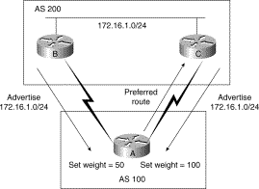
Weight

Slide 69
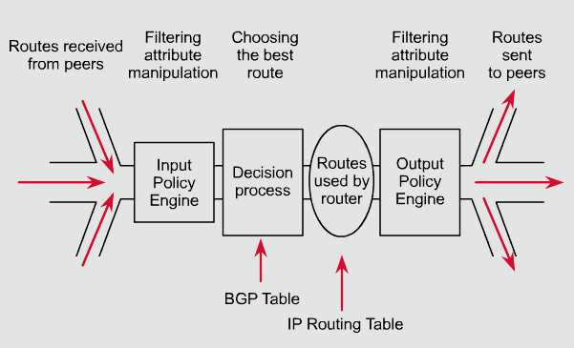
bgp routing

Slide 70
BGP Route Selection Algorithm
BGP selects only one path as the best path.
When the path is selected, BGP puts the selected path in its routing table and propagates the path to its neighbors.
BGP uses the following criteria, in the order presented, to select a path for a destination:
If the path specifies a next hop that is inaccessible, drop the update
2. Prefer the path with the largest weight.
3. If the weights are the same, prefer the path with the largest local preference.
4. If the local preferences are the same, prefer the path that was originated by BGP running on this router.
5. If no route was originated, prefer the route that has the shortest AS_path.

Slide 71
BGP Route Selection Algorithm
6. If all paths have the same AS_path length, prefer the path with the lowest origin type (where IGP is lower than EGP, and EGP is lower than Incomplete).
7. If the origin codes are the same, prefer the path with the lowest MED attribute.
8. If the paths have the same MED, prefer the external path over the internal path.
9. If the paths are still the same, prefer the path through the closest IGP neighbor.
10. Prefer the path with the lowest IP address, as specified by the BGP router ID.

Slide 72
The Route Map Command
Router(config)#route-map map-tag [permit | deny] [sequence-number]
BGP input and output policies are defined, generally, using route maps.
Route maps are used with BGP to control and modify routing information and to define the conditions by which routes are redistributed between routing domains.
Note that map-tag is a name that identifies the route map; the sequence-number indicates the position that an instance of the route map is to have in relation to other instances of the same route map.
Instances are ordered sequentially, starting with the number 10 by default.

Slide 73
Implementing Policy
Traffic inside and outside an AS always flows according to the road map laid out by routes.
Altering the routes changes traffic behavior.
How do I prevent my private networks from being advertised?
How do I filter routing updates coming from a particular neighbor?
How do I make sure that I use this link or this provider rather than another one?

Slide 74
Using BGP Attributes
When a BGP speaker receives updates from multiple autonomous systems that describe different paths to the same destination, it must choose the single best path for reaching that destination.
Once chosen, BGP propagates the best path to its neighbors.
The decision is based on the value of attributes (such as NEXT_HOP or LOCAL_PREF) that the update contains and other configurable BGP factors.

Slide 75
BGP Scaling Techniques
Dynamic reconfiguration
Peer groups
Route flap damping
Route reflectors

Slide 76
BGP Dynamic Reconfiguration: Soft Reconfig
Problem:
Hard BGP peer clear required after every policy change because the router does not store prefixes that are denied by a filter.
Hard BGP peer clearing consumes CPU and affects connectivity for all networks.
Solution:
Soft-reconfiguration

Slide 77
BGP Dynamic Reconfiguration: Soft Reconfig
New policy is activated without tearing down and restarting the peering session
Per-neighbour basis
Use more memory to keep prefixes whose attributes have been changed or have not been accepted

Slide 78
BGP Dynamic Reconfiguration: RT Refresh
Facilitates non-disruptive policy changes
No configuration is needed
No additional memory is used
Requires peering routers to support “route refresh capability” – RFC2918
clear ip bgp x.x.x.x in tells peer to resend full BGP announcement
Use Route Refresh capability if supported
find out from “show ip bgp neighbor”
uses much less memory
Otherwise use Soft Reconfiguration

Slide 79
BGP Peer Groups
Without peer groups
iBGP neighbours receive same update
Large iBGP mesh slow to build
Router CPU wasted on repeat calculations
Solution – peer groups!
Group peers with same outbound policy
Updates are generated once per group

Slide 80
BGP Peer Groups - Advantages
Makes configuration easier
Makes configuration less prone to error
Makes configuration more readable
Lower router CPU load
iBGP mesh builds more quickly
Members can have different inbound policy
Can be used for eBGP neighbours too!

Slide 81
BGP Route Flap Damping
Route flap
Going up and down of path or change in attribute
BGP WITHDRAW followed by UPDATE = 1 flap
eBGP neighbour going down/up is NOT a flap
Ripples through the entire Internet
Wastes CPU
Damping aims to reduce scope of route flap propagation

Slide 82
BGP Route Flap Damping
Requirements
Fast convergence for normal route changes
History predicts future behaviour
Suppress oscillating routes
Advertise stable routes
Implementation described in RFC2439

Slide 83
BGP Route Flap Damping Operation
Add penalty (1000) for each flap
Change in attribute gets penalty of 500
Exponentially decay penalty
half life determines decay rate
Penalty above suppress-limit
do not advertise route to BGP peers
Penalty decayed below reuse-limit
re-advertise route to BGP peers
penalty reset to zero when it is half of reuse-limit

Slide 84
Operation
4000
Suppress limit
3000
Penalty
2000
Reuse limit
1000
0
0
1
2
3
4
5
6
7
8
9
10
11
12
13
14
15
16
17
18
19
20
21
22
23
24
25
Time
Network
Announced
Network
Not Announced
Network
Re-announced

Slide 85
Operation
Care required when setting parameters
Penalty must be less than reuse-limit at the maximum suppress time
Maximum suppress time and half life must allow penalty to be larger than suppress limit

Slide 86
Scaling iBGP mesh
Avoid n(n-1)/2 iBGP mesh
n=1000 ⇒ nearly half a million ibgp sessions!
13 Routers ⇒
78 iBGP Sessions!
Two solutions
Route reflector – simpler to deploy and run
Confederation – more complex, corner case benefits, sub-AS’s

Slide 87
Scaling iBGP mesh
Implementing BGP route reflectors does not require major changes to existing configuration and topology, as opposed to confederation (please do not give up already!).
It implies choosing routers that will act as a focal point for iBGP sessions within a single AS, running a single IGP.

Slide 88
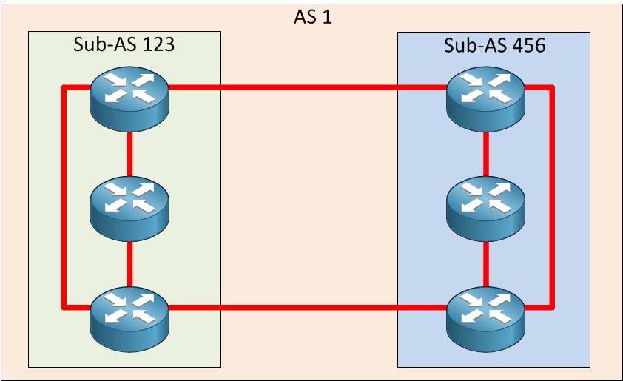
Scaling iBGP mesh
Implementing BGP confederations involves quite a change to BGP configurations and the architecture itself, adding more complexity to achieve stable and scalable BGP network.

Slide 89
Scaling iBGP mesh
The main difference between the two lies in the fact that a confederation may contain different IGPs, adding more flexibility to scaling your network.
Therefore, choosing a confederation over route reflectors would be more appropriate in case your IGP is exceeding its scalability limit and becomes unmanageable, and you would like to manage many independent ASs, each of which may run a different IGP.

Slide 90
Route Reflector: Principle
Route Reflector
A
AS 100
B
C

Slide 91
Route Reflector
Reflector receives path from clients and non-clients
Selects best path
If best path is from client, reflect to other clients and non-clients
If best path is from non-client, reflect to clients only
Non-meshed clients
Described in RFC2796
Clients
Reflectors
A
B
C
AS 100

Slide 92
Route Reflector Topology
Divide the backbone into multiple clusters
At least one route reflector and few clients per cluster
Route reflectors are fully meshed
Clients in a cluster could be fully meshed
Single IGP to carry next hop and local routes

Slide 93
Route Reflector: Benefits
Solves iBGP mesh problem
Packet forwarding is not affected
Normal BGP speakers co-exist
Multiple reflectors for redundancy
Easy migration
Multiple levels of route reflectors

Slide 94
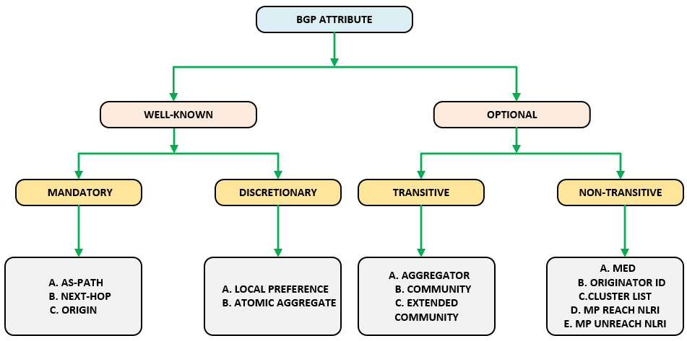

Slide 95
BGP ATTRIBUTES: WEIGHT
Weight
Weight is a Cisco defined attribute that is local to a router.
The weight attribute is not advertised to neighboring routers.
If the router learns about more than one route to the same destination, the route with the highest weight is preferred.

Slide 96
BGP ATTRIBUTES: AS-PATH
AS-Path
When a route advertisement passes through an autonomous system, the AS number is added to an ordered list of AS numbers that the route advertisement has traversed.

Slide 97
BGP ATTRIBUTES: ORIGIN
Origin:
The origin attribute indicates how BGP learned about a particular route. The origin attribute can have one of three possible values:
IGP: The route is interior to the originating AS. This value is set when the network router configuration command is used to inject the route into BGP.
EGP: The route is learned via Exterior Gateway Protocol (EGP).
Incomplete: The origin of the route is unknown or is learned some other way. An origin of incomplete occurs when a route is redistributed into BGP.

Slide 98
BGP ATTRIBUTES: NEXT-HOP
Next-hop
The eBGP next-hop attribute is the IP address that is used to reach the advertising router.
For eBGP peers, the next-hop address is the IP address of the connection between the peers.

Slide 99
BGP ATTRIBUTES: LOCAL PREFERENCE
Local Preference
The local preference attribute is used to prefer an exit point from the local autonomous system.
Unlike the weight attribute, the local preference attribute is propagated through-out the local AS.
If there are multiple exit points from the AS, the local preference attribute is used to select the exit point for a specific route.

Slide 100
BGP ATTRIBUTES: ATOMIC AGGREGATE
Atomic Aggregate:
Notes that route summarization has been performed.

Slide 101
BGP ATTRIBUTES: COMMUNITY
Community
The community attributes provides a way of grouping destinations, called communities, to which routing decisions (such as acceptance, preference and redistribution) can be applied.
Route maps are used to set the community attribute.
The predefined community attributes are as follows:
Aggregator: Identifies the router and AS where summarization was performed.

Slide 102
BGP ATTRIBUTES: COMMUNITY
Multi-Exit Discriminator(MED): The multi-exit discriminator(MED) or metric attribute is used as a suggestion to an external AS regarding the preferred route into the AS.
Originator ID: The originator ID attribute identifies a route reflector.
Cluster List: The cluster list attribute records the route reflector clusters the route has traversed.
MP Reach NRLI
MP Unreach NRLI

Slide 103
BGP ATTRIBUTES: EXTENDED COMMUNITY
MPLS L3VPN

Slide 104
YOUTUBE BGP BASICS
https://www.youtube.com/watch?v=z8INzy9E628
https://www.youtube.com/watch?v=AjkU7Hw2TY4

Slide 105
YOUTUBE BGP CONFIGURATION
UNDERSTANDING BGP NEIGHBORS (STARTING BGP CONFIG)
https://www.youtube.com/watch?v=66oksttO9fQ&list=PLJqb_j53o7BiVPaFGQxEHhGx-ximMukwH&index=4
IBGP NEIGHBORS CONFIGURATION
https://www.youtube.com/watch?v=y5va67BO2Pw&list=PLJqb_j53o7BiVPaFGQxEHhGx-ximMukwH&index=5
EBGP CONFIGURATION
https://www.youtube.com/watch?v=8ciI6-maH7Q&list=PLJqb_j53o7BiVPaFGQxEHhGx-ximMukwH&index=12

Slide 106
WIRESHARK

